Slide 1

Service AI that Delivers the Right Fix, Right Part, Right Now.
AI-powered Autonomous Support for Mission-critical Service at Scale
Hypertec Case Study
Ashok Kartham, CEO, Circuitry.ai
Ramzi El-Achkar, Director of Hardware Support, Hypertec
Aug 2026

Slide 2
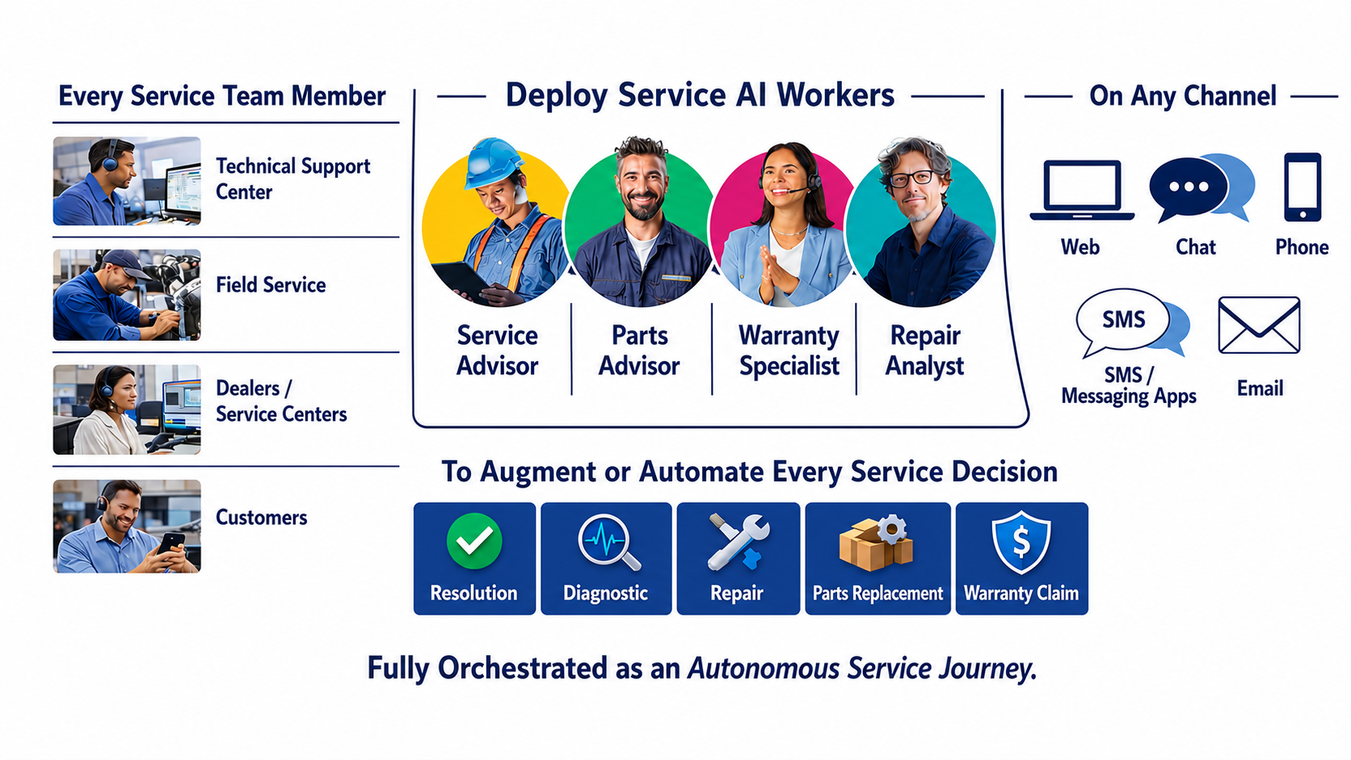
Across all channels, Circuitry.ai’s AI Workers augment service teams with faster, more consistent decisions, then orchestrate those decisions into governed, autonomous service journeys.

Slide 3

ABOUT HYPERTEC
3,000+
80+
Customers worldwide
Countries served
Global provider of high-performance computing, AI infrastructure, data center solutions, custom manufacturing, and lifecycle services.
Supports mission-critical data center environments where uptime and rapid response are essential.
TRUSTED BY TECHNOLOGY LEADERS
NVIDIA · Intel · AMD · Microsoft · Samsung

Slide 4
FROM REACTIVE SUPPORT TO AUTONOMOUS SERVICE
Lower cost to serve, faster and more accurate answers — AI absorbs routine support volume so experts focus on the complex work that drives growth
Service challenges
Business impact
Rapid AI-driven growth without adding support headcount
Majority of support emails deflected by AI auto-responses
Customers need faster, accurate answers on complex GPU systems
Autonomous Support Journey powered by Circuitry.ai
Service Decision Intelligence
Log file analysis pinpoints the resolution instantly
Mission-critical data center SLAs with no tolerance for delay
Parts orders and field escalations triggered automatically
Tribal knowledge fragmented across experts, tools and sites
Knowledge base mined from historic agent responses
HOW CIRCUITRY.AI DELIVERS IT
Knowledge mining across Confluence and SharePoint
AI email and phone support agents
Orchestration across JIRA, SAP and Field Service
Continuous learning on every resolution

Slide 5
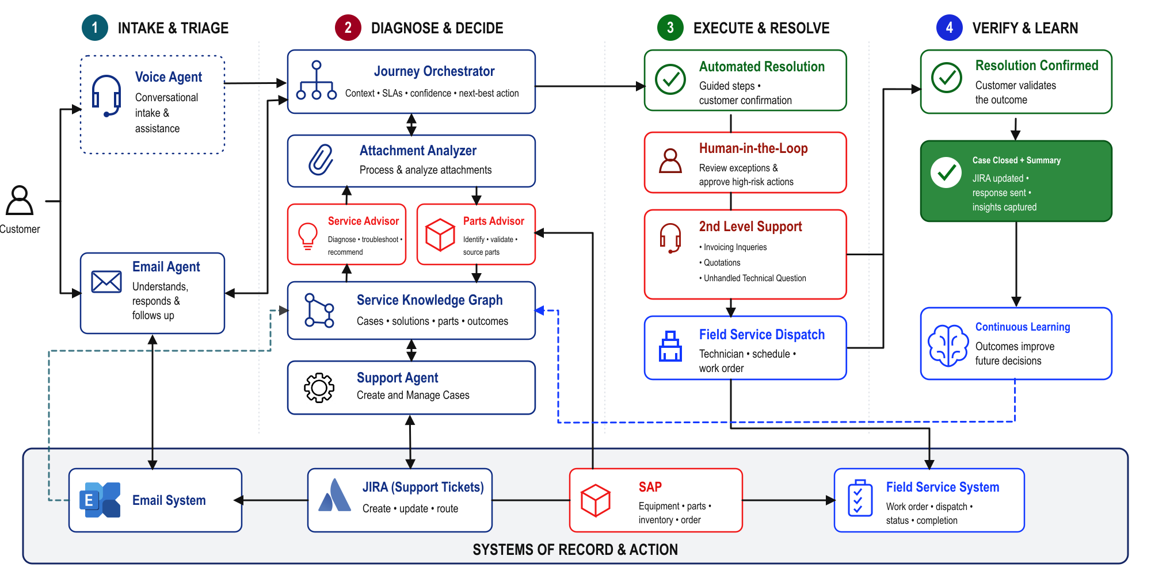
SERVICE JOURNEY CUSTOMER REQUEST THROUGH RESOLUTION

Slide 6
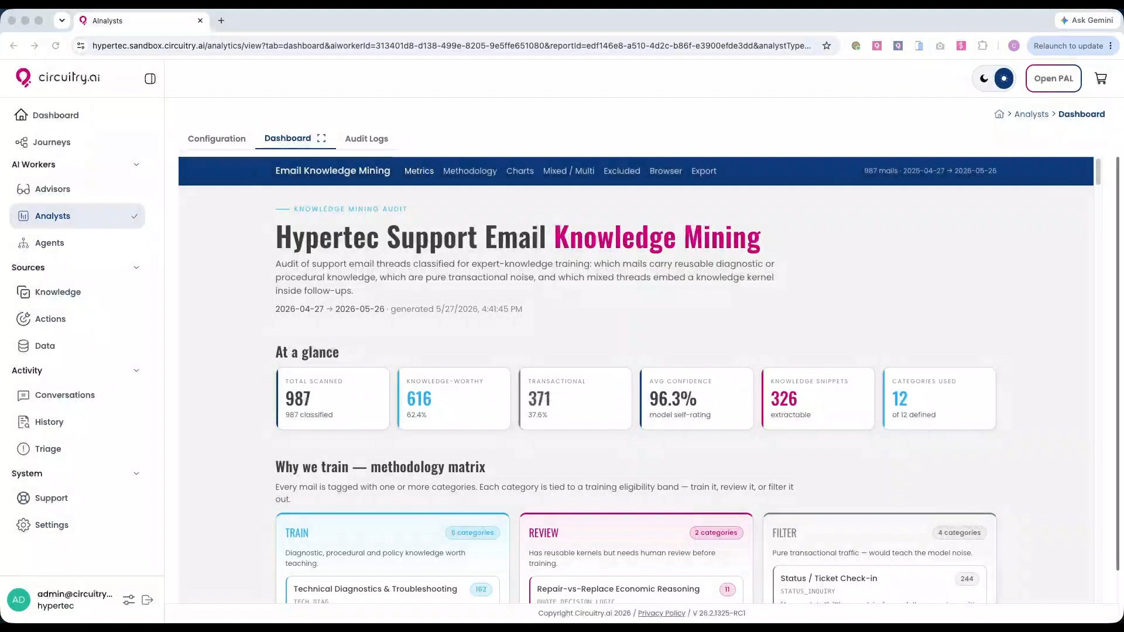
HYPERTEC KNOWLEDGE MINING

Slide 7
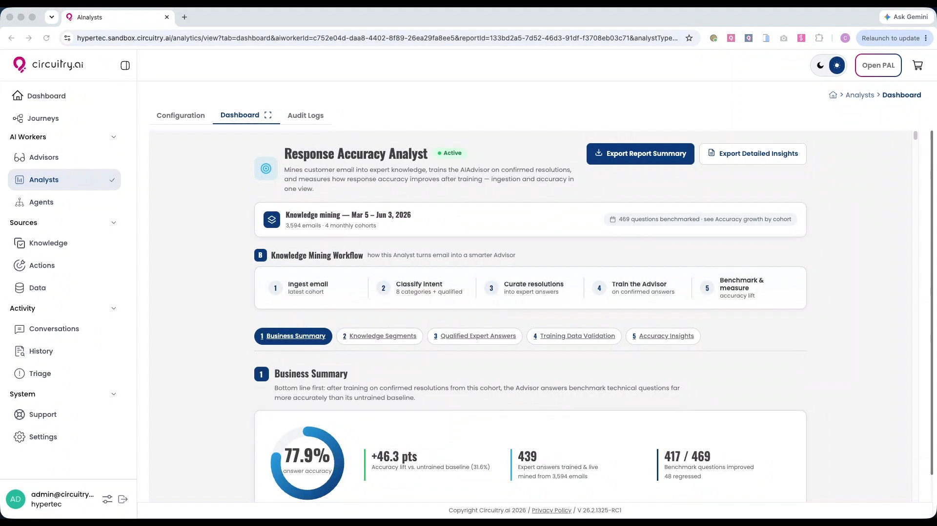
HYPERTEC KNOWLEDGE MINING

Slide 8
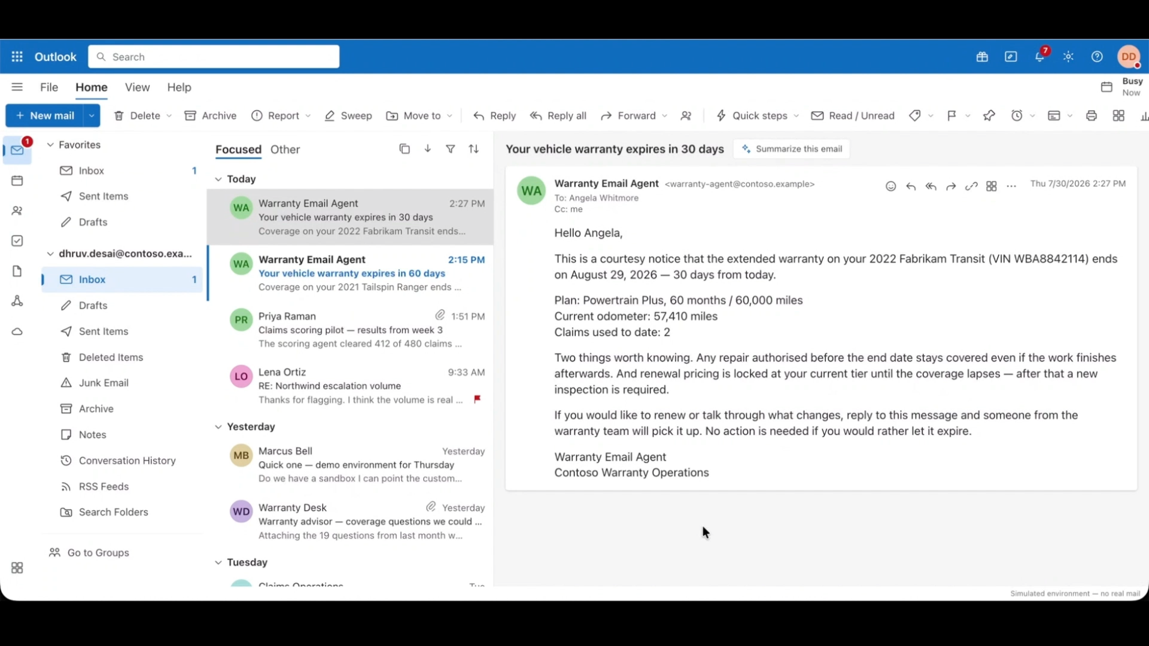
HYPERTEC TECHNICAL SUPPORT

Slide 9

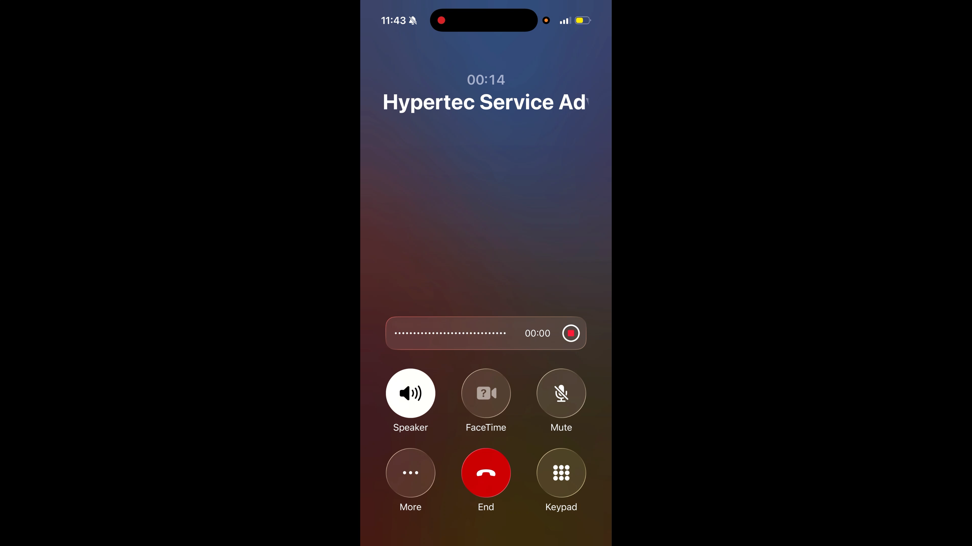

DEMO VOICE AGENT
Voice Agent
Hands-free support: Get answers without stopping work
Faster fixes: Instant guidance speeds troubleshooting
Expert knowledge on demand: Access info anywhere, anytime
Safer, more productive work: Stay focused without device handling

Slide 10
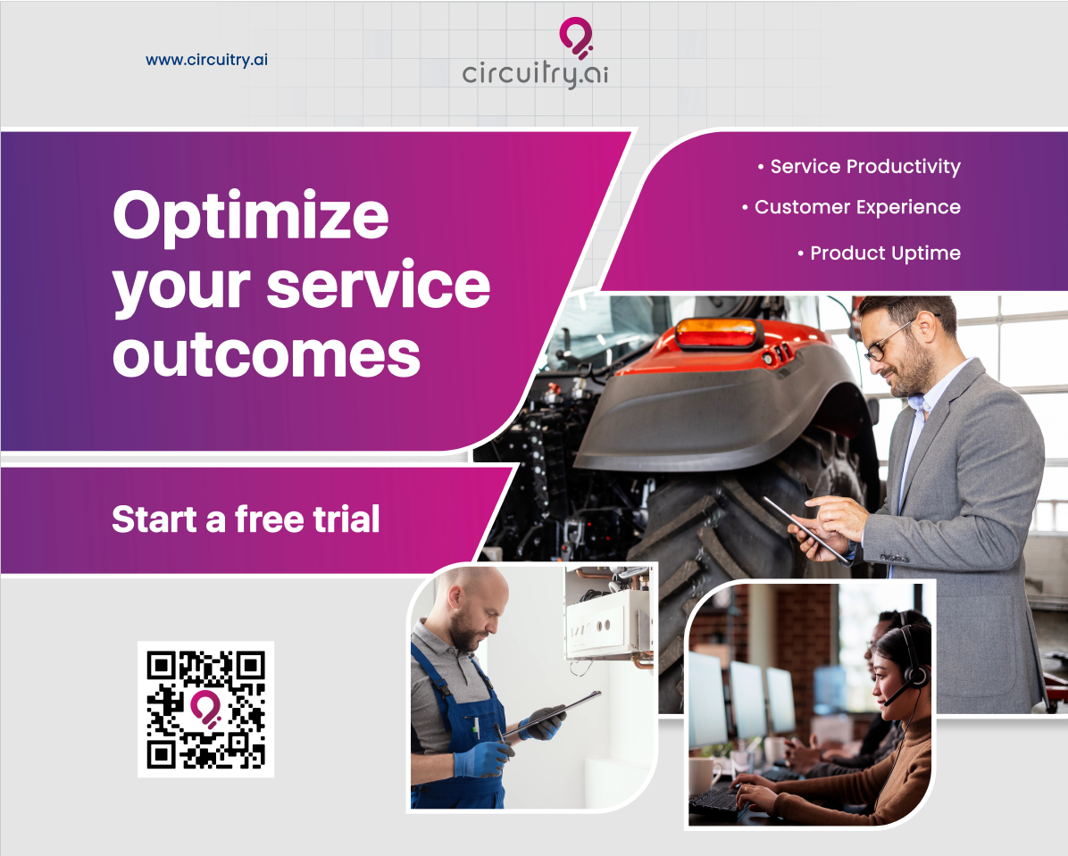

CONTACT US
Visit us at Booth 12 or meet us at the AI Innovations Lab
Email
info@circuitry.ai
Website
https://circuitry.ai

